Slide 1
CO226 DATABASE PROJECT

Slide 2
Problem
At Highway Toll booths:
Ticketing is done manually
No license/eco test or insurance validation
Long queues

Slide 3
Solution
Real Time Vehicle Identification
Using Image Processing

Slide 4
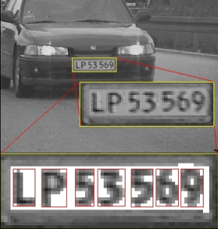
Solution
At the highway entrance, Registration number of vehicles can be detected using camera images
No human interaction
No vehicle queue

Slide 5



Solution
Each identified vehicle is searched in the existing database which has all the details about a particular vehicle
Observing previous records, License/ Insurance validity or Eco test information can be obtained.

Slide 6
Benefits
No long queues
Saves time
Easy payment
No illegal vehicles
High speed checking

Slide 7
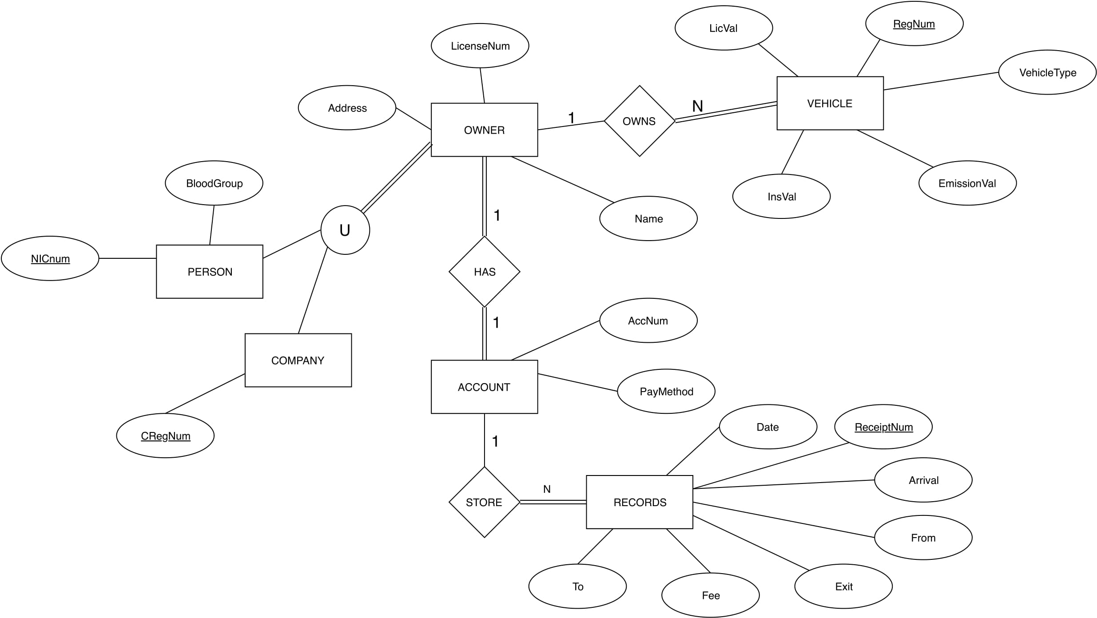
EER Diagram

Slide 8
Demonstration
The system for the administrators
-for registrations
The system for the Toll booth
-to track the vehicles
Camera
Image
Check
Validity
Extract
Vehicle No

Slide 9
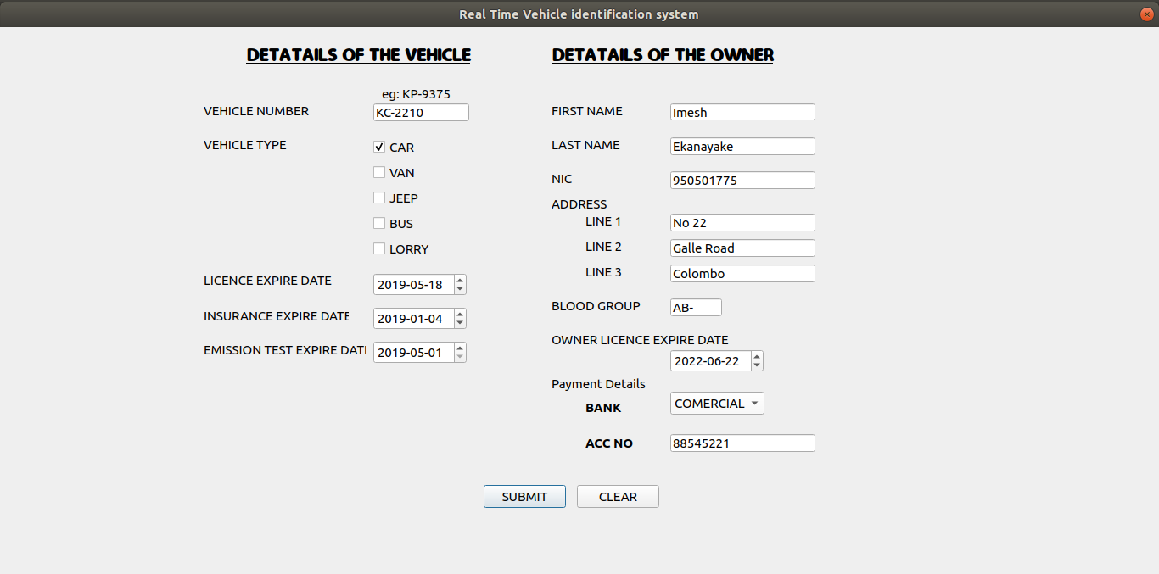
Interfaces for clients
For admins

Slide 10
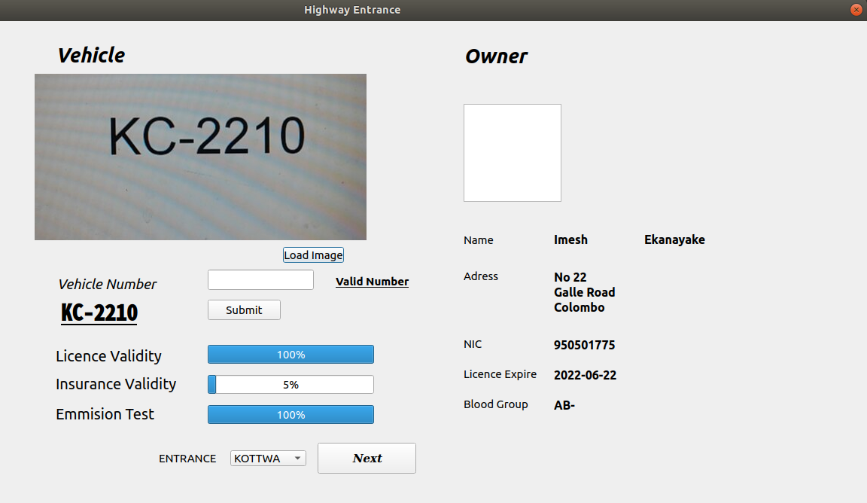
Interfaces for clients
At toll booth

Slide 11
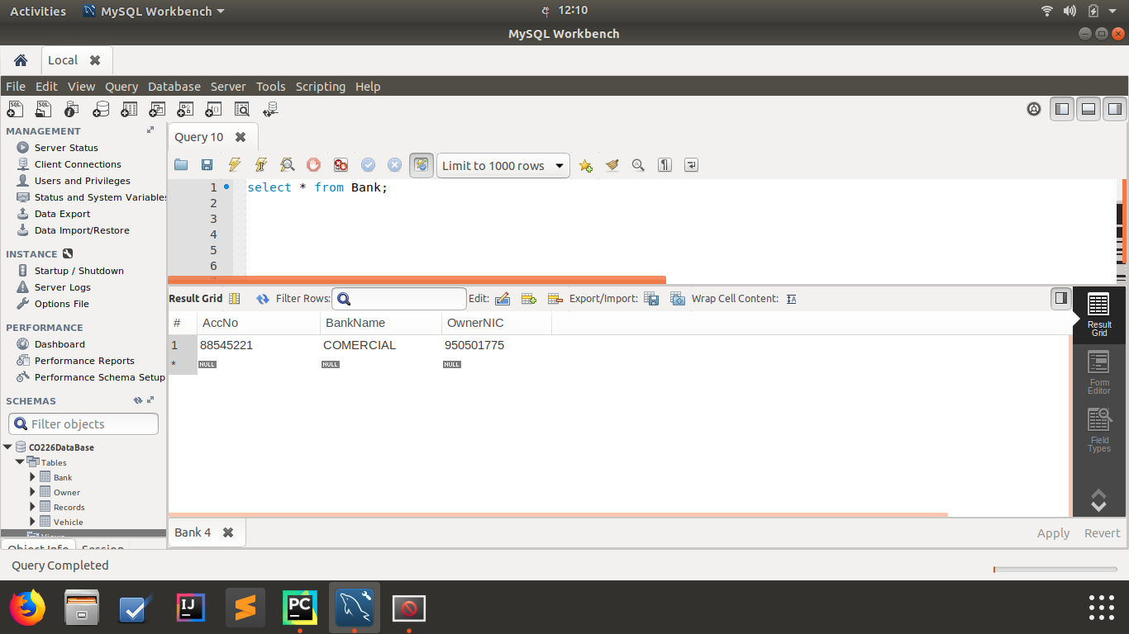
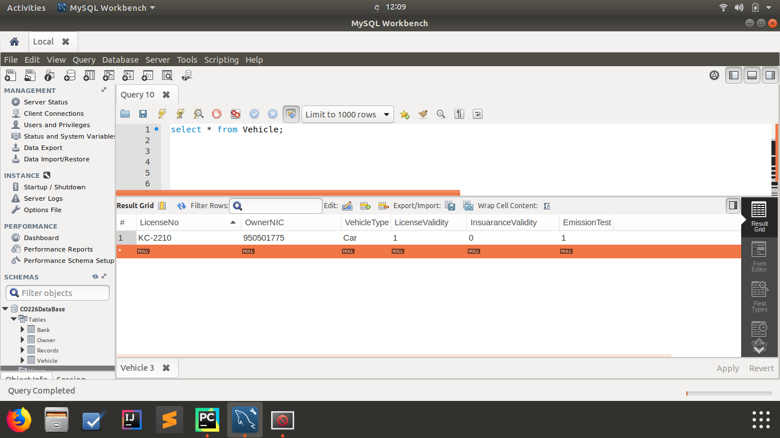
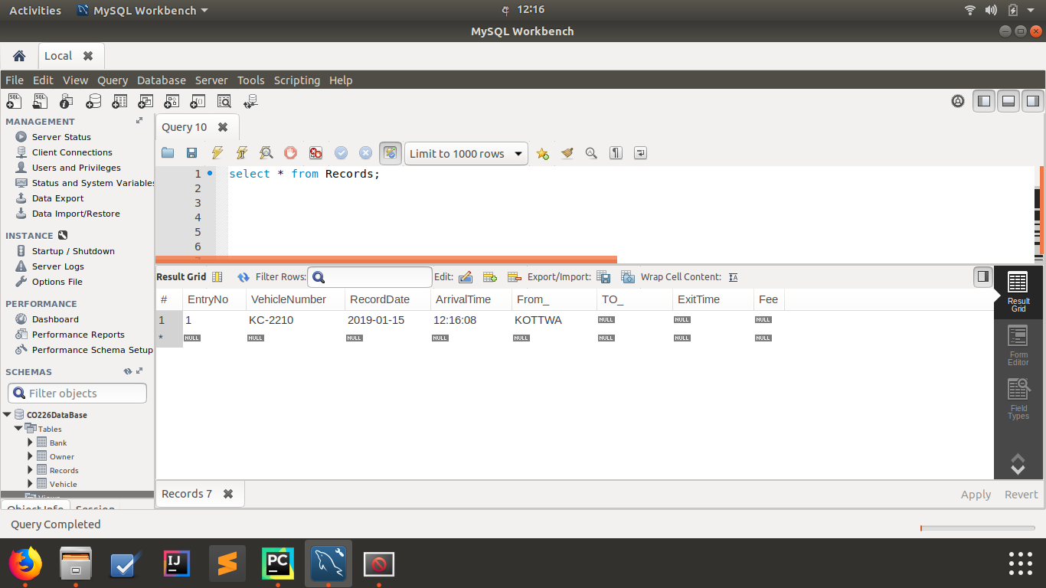
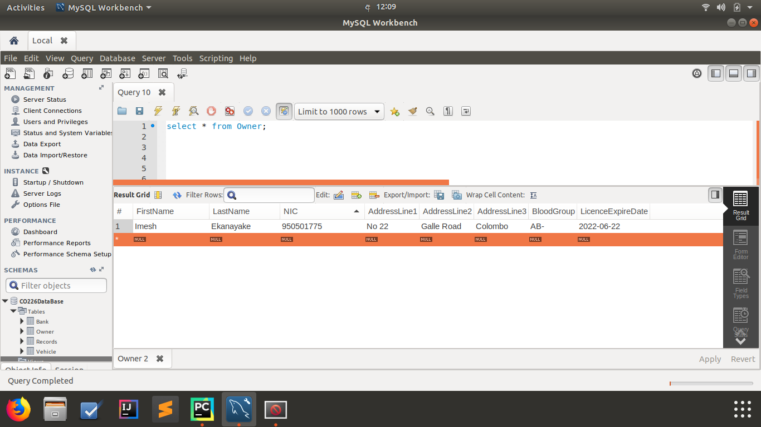
Database overview
Bank
Vehicle
Owner
Records

Slide 12
Database and other techniques we have used
Triggers
Views
Procedure calls
MySQL
Python
Pysql
Tessaract OCR library

Slide 13

Other Implementations
Road surveying
Traffic control
Car-park ticketing
Company vehicle records
Prediction of accidents

Slide 14
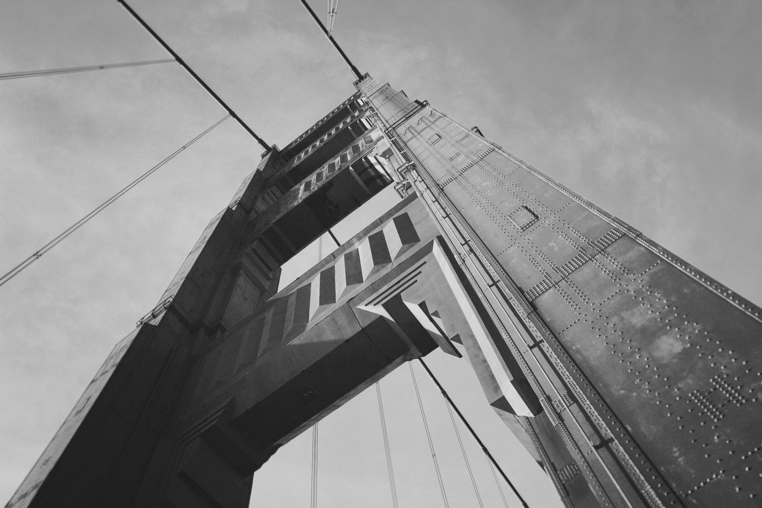
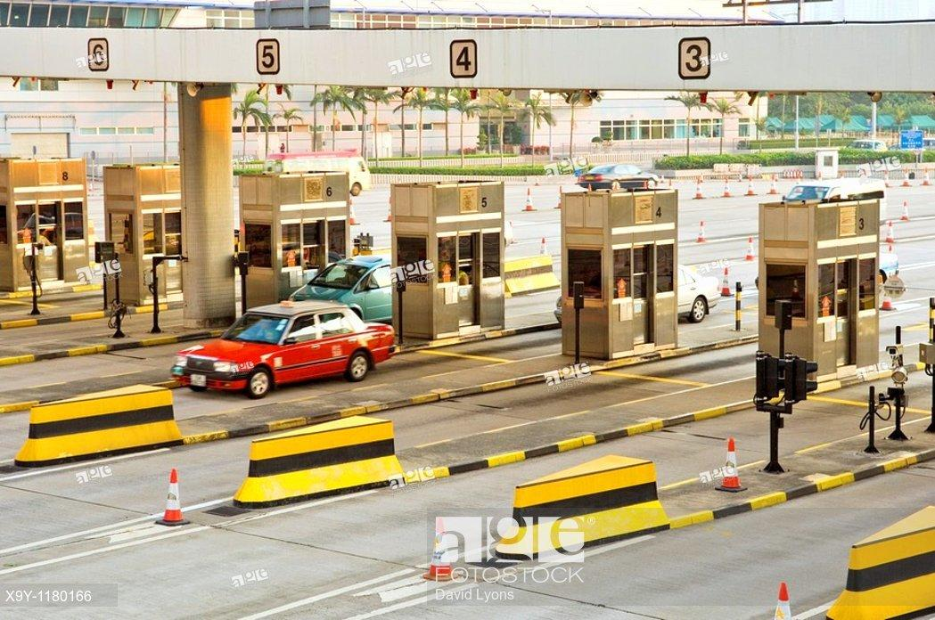
Thanks!
Group members
E15/092 Ekanayake I.U.
E15/173 Karunarathna S.D.D.D.
E15/280 Premathilaka M.P.U.
E15/316 Samarasinghe U.G.S.B.
E15/350 Tennakoon M.P.B.

Slide 15
Q & A

